Slide 1
PlugNHarvest simulation model
Documentation
Last modified on 13.05.2019
Ana Constantin

Slide 2
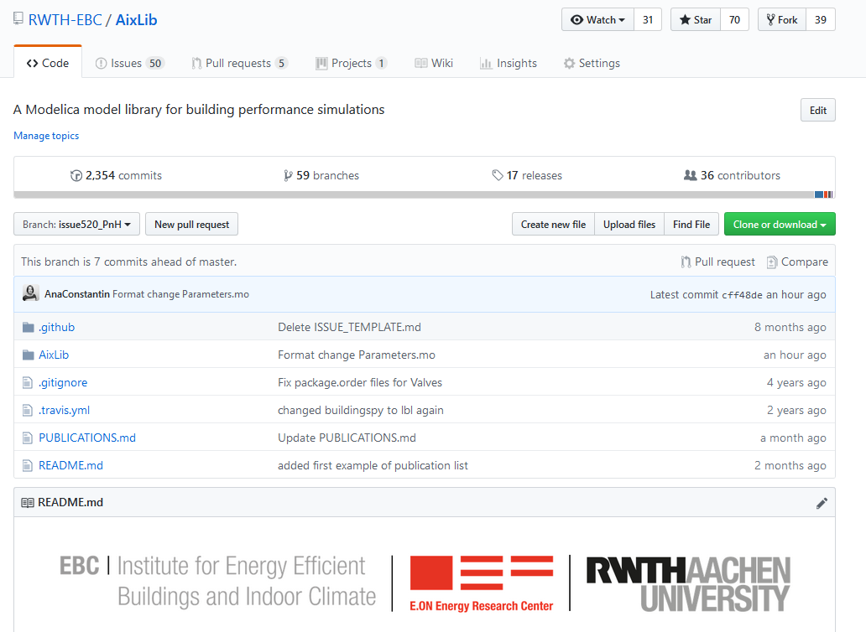
Clone or Download
Go to this link
Check if „issue520_PnH“ is selected
Clone or download the repository

Slide 3
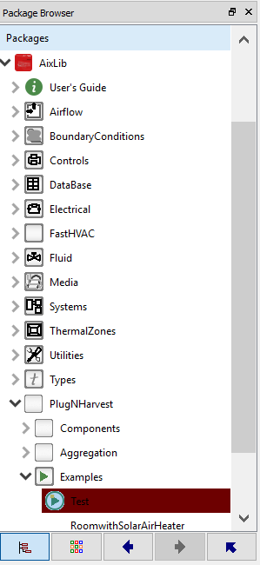
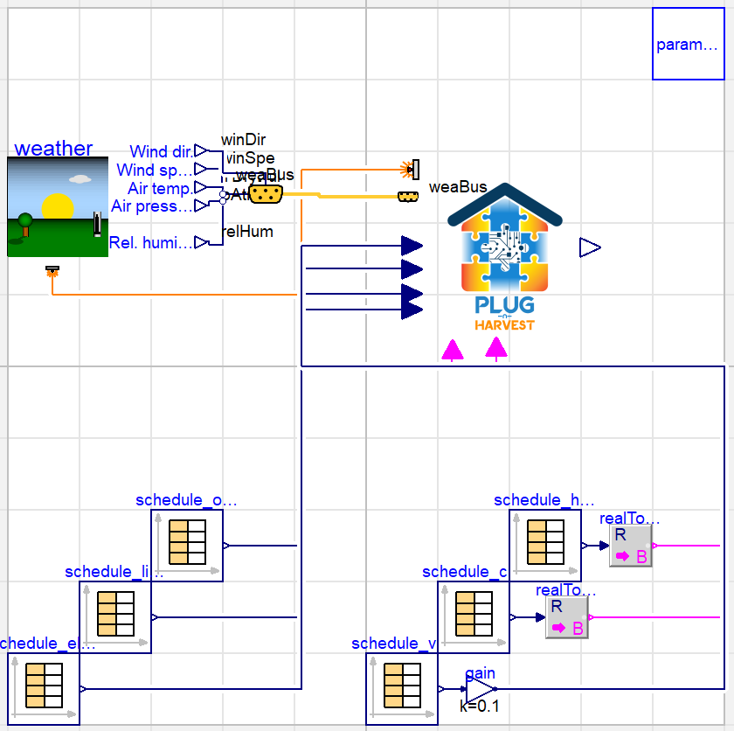
Aixlib with PnH in Dymola
Parameter Block / Fast Input mask
Ambient
conditions
Room model
Internal gains
Heating, cooling, ventilation

Slide 4
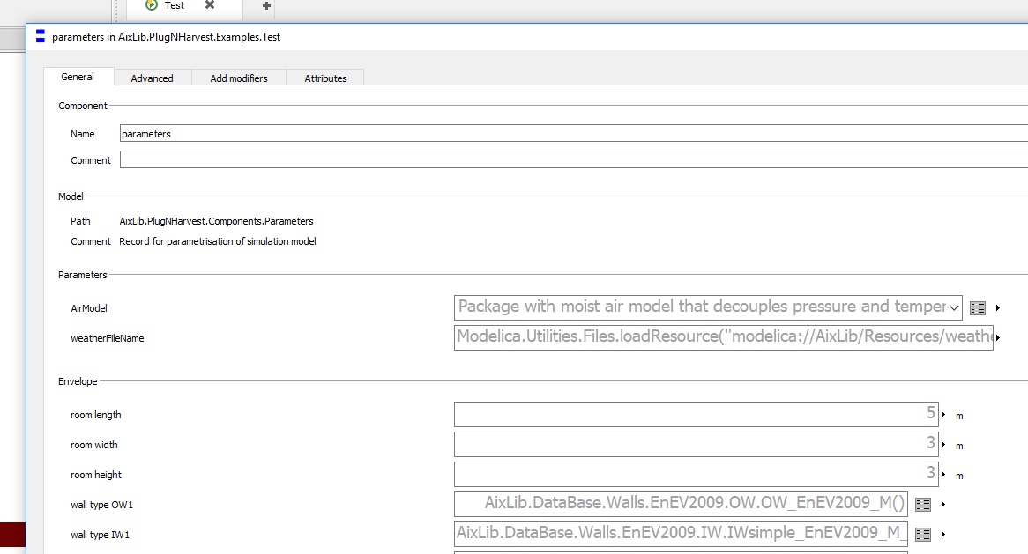
Parameter Block
General: have to be set
Advanced: have default values, can be re-set if desired
Hidden (only on the model level): pre-set, since these values are rarely dependent on the use case. Can be re-set if desired, but we recommend re-setting them only in the simulation model, so the changes are noticeable.

Slide 5
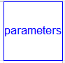
Components of simulation model
Model name
AixLib.PlugNHarvest.Examples.Test
Main model
Room envelope + internal gains + energy system + control
Boundary conditions
Weather
Schedules internal gains: occupants, lights, electrical appliances
Schedules HVAC: heating cooling ventilation
Parameters for the whole model
With the exception of one parameter, the whole
simulation can be configured over this list of parameters
Exception: the surface orientation for the calculation of the solar radiation on the facade
In the weather model: Surface orientation data (chose or create a record with the needed orientation)
Connect the correct solar output from the weather model to the room model (if a record with 4 orientations is provided, and the third orientation is needed, connect the third element of the output vector )

Slide 6
Parameters
General: have to be set theoretically foe each use case
Advanced: have default values, can be re-set if desired for each use
Hidden (only on the model level): pre-set, since these values are rarely dependent on the use case. Can be re-set if desired, but we recommend re-setting them only in the simulation model, so the changes are noticeable.
Might be that the list in the presentation is incomplete, since this exceeds goal of the presentation
Parameters for the whole model
Air model (moist air)

Slide 7
Type of room - Envelope
One outer wall, the rest inner walls towards the building
Parameters:
General:
room height, length and width
wall types
window type
Advanced
Outer walls: solar absorbance, heat convection model
Sunblind
Infiltration
Heat bridge
Hidden
Initial temperatures of walls

Slide 8
Type of room - Smart facade
General
Choosing the elements of the facade
Parameters for PV: number of panels, record, maximal power output
Parameters for solar heater
Advanced
Hidden

Slide 9
Internal gains
Persons
General:
density of occupants
heat output from activity
Advanced
ratio convective heat from total heat output
Hidden
Start temperature, surface area for a human, temperature dependence of heat output
Lights & electrical appliances
General
Specific P_{el}/m² for light source / appliances
Advanced
Coefficient P_{th}/P_{el} for lights / appliances
Coefficient P_{th,radiative}/P_{el} for lights / appliances
Hidden
Emissivity of lights / appliances

Slide 10
Energy system + Control
Parameters
General
Maximal power output for heater / cooler
Set temperature for heating / cooling
Outside temperature under which heater starts
Advanced
Is heater / cooler electric
Electrical efficiency of heater / cooler
Hidden
Parameters for internal PI controllers

Slide 11
Boundary conditions
Parameters
General
Latitude and longitude of location
File for weather data
Schedules for internal gains and HVAC
Advanced
Hidden
Ground reflection for weather model
Model used for solar radiation
Output from weather model
Interpolation of data from tables
Extrapolation of data from tables: periodic

Slide 12
Some examples for setting parameters for an office
Sources for the values are given and detailed at the end of the presentation in the Bibliography
Internal gains
Persons
Density
Schedule – in the simulation model a simpler profile 09:00 – 17:00 is used
Lights & electrical appliances
Modelling
Types
Schedule - in the simulation model a simpler profile 09:00 – 17:00 is used
Energy system
Efficiency for different types of equipment
Control: set temperatures

Slide 13
Internal gains – Persons - User density
Zone | Density | Source
Office | 0.06 / 0.07 / 0.1 Persons / m² | DIN 18599-10.2 (A.2), GER
 | 0.4 Persons / m² | ASHRAE 90.1 – Table G-B, US

Slide 14
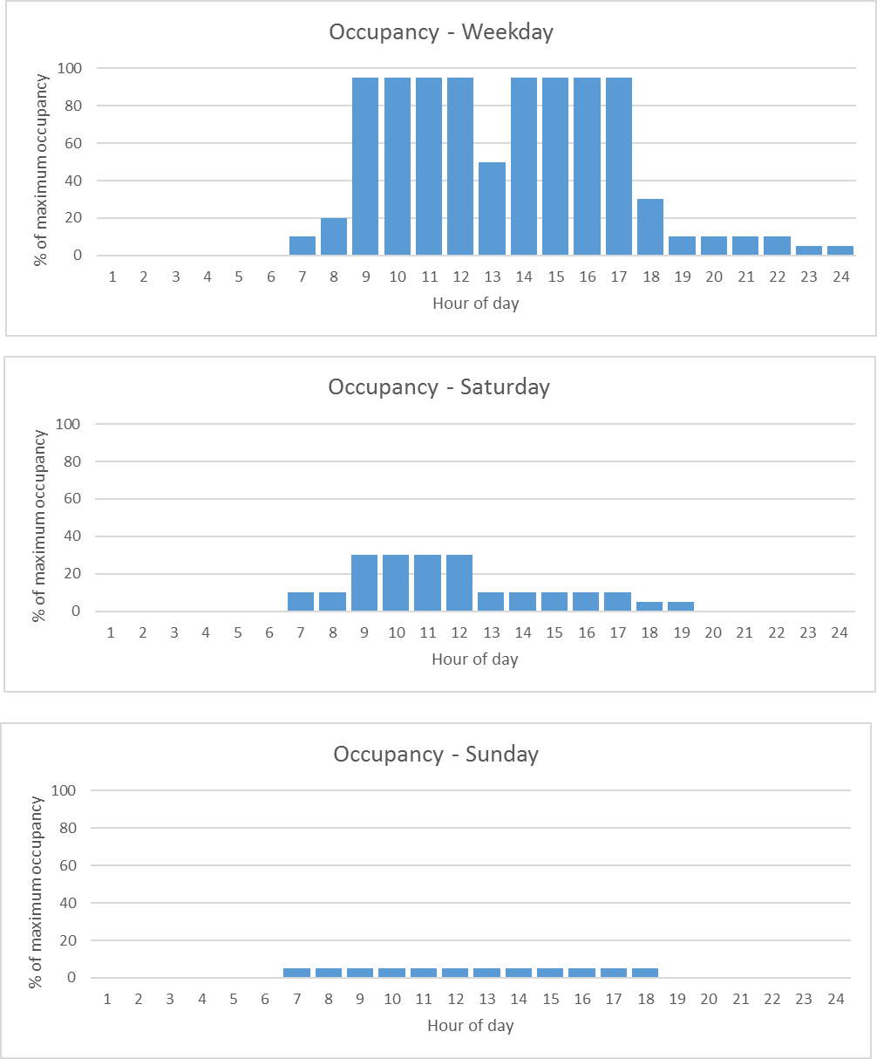
Internal gains – Persons – Presence profiles (ASHRAE 90.1_G)
Service / Office

Slide 15
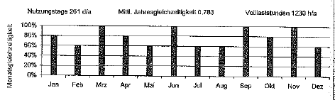
Internal gains – Persons – Monthly variation (Source SIA 2024)
Office (2-6 Persons)

Slide 16
Internal gains – Lighting and electrical appliances
Equipment such as lighting and auxiliary machines (computers, ovens, cooling boxes) depends on zone type and leads to an electrical and thermal load
Data needed for modelling lighting and auxiliary machines
Load profiles (percentual) depending on zone type → table
Electrical or heat load equipment based on zone type / type of activity → constant, one value in W/m²
Efficiency electrical to thermal for type of equipment → constant, one value
Parameters:
Zone Area
Specific P_{electric /} m² for zone type
Coefficient P_{thermal} from P_{electric}
Coefficient P_{th,rad} from P_{thermal}
Emissivity
P_{th,conv}
P_{th,rad}
Schedule
P_{el}

Slide 17
Internal Gains – Lights - Requirements
Zone | Heat load | Energy requirement | Source
Office | 500 lx 0.8 m | 25 Wel/m² – Halogen 9 Wel/m² – Flourescent 5 Wel/m² – LED | DIN 18599-10.2 (A2) CommONEnergy2013 (Fig 38, Page 64)
 | 12 Wth/m² | 13 Wel/m² 90% @[WWW1] | Clark2015, Table A2, US
 |  | 47 / 41 / 22 / 13 / 8 Wel/m² | VDI 3807-4, Table 3, (2) GER

Slide 18
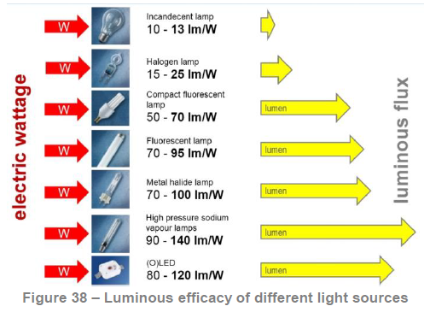
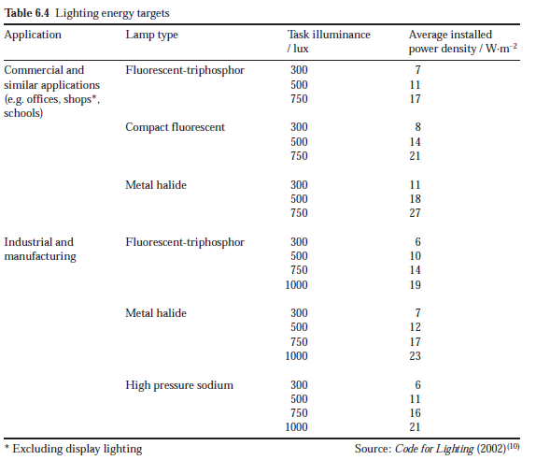
Internal gains – Lights - Type of lamps
Source: CommONEnergy
Source: CIBSE, Guide A

Slide 19
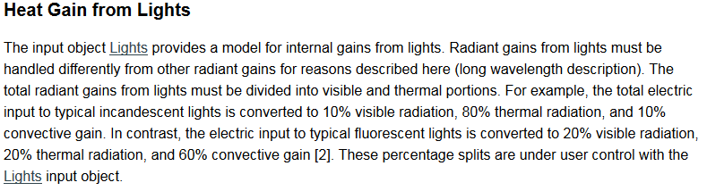
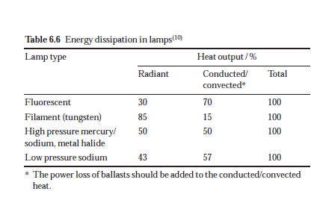
Internal gains – Lights - Efficiency
Source [WWW1]
Source: CIBSE, Guide A

Slide 20
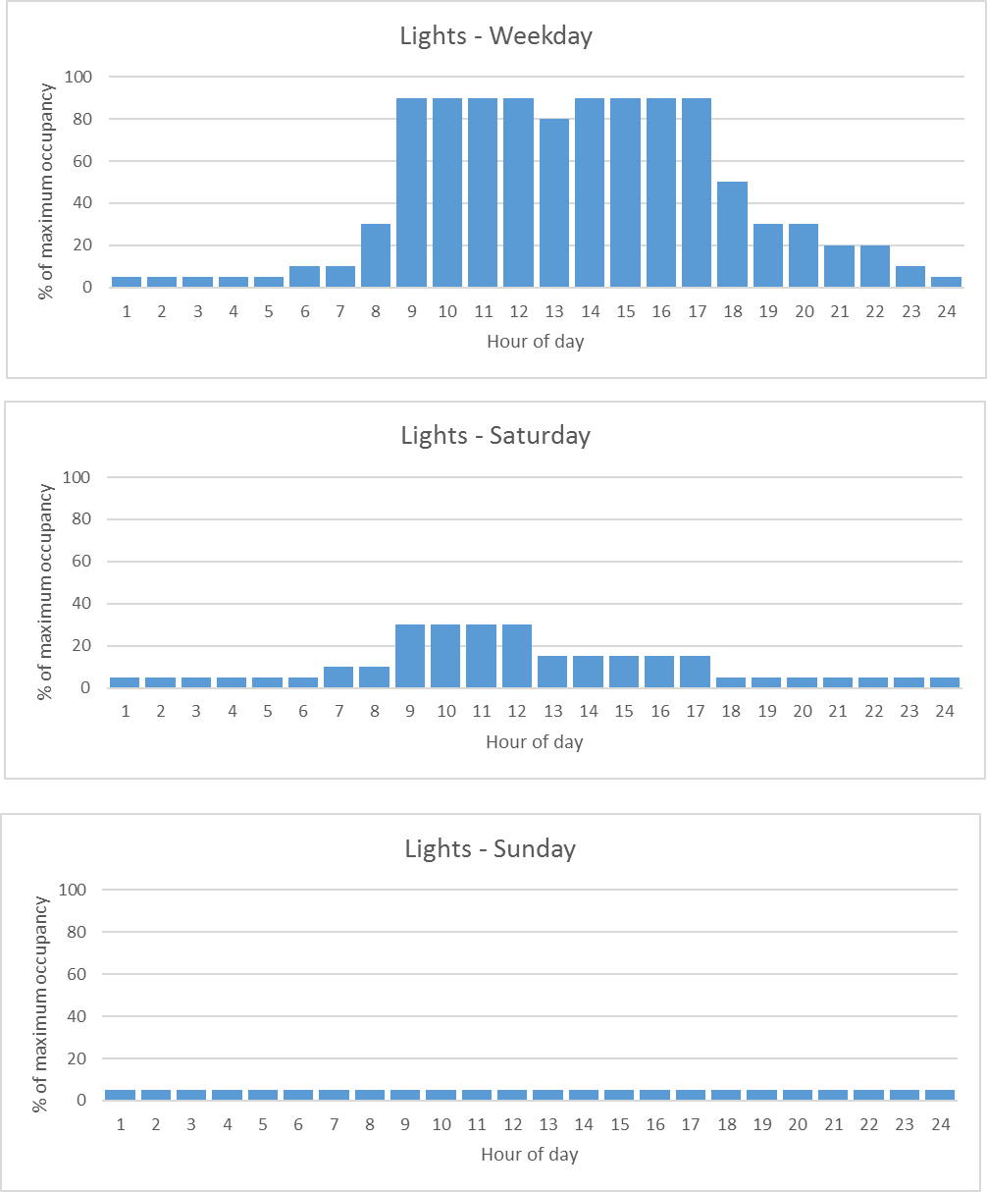
Internal gains – Lights - Profiles (ASHRAE 90.1_G)
Service / Office

Slide 21
Internal gains – Appliances
Auxiliary machines (based on [ASHRAE_Fundamentals_2001])
Office – used for office
Heat gain 50% of rated hourly input → 100 % sensible (22% radiant, 78 % convective as a mean between equipment with fans and without fans)
Zone | Heat load | Schedule | Source
Office | 2.8 / 7.1 / 15 W/m² (small, middle, high) | 6 full h / d | DIN 18599-10.2 (A2)

Slide 22
Energy system – Temperature and Ventilation, requirements
Zone | Heating / Cooling / Ventilation with outside air
Office (2-6 persons) | 21 °C / 24 °C / 4 m³/(h*m²) DIN 18599-10.2 (A2)

Slide 23
Energy System - Efficiency
Type of equipment | Efficiency (available for different years)
Boiler - Gas | Seasonal efficiency 86-95% 102-108% (condensation boiler) Source: [Worm2015]
Heat pump | COP (coefficient of performance): 1.9-4.3 DIN 18599-5, Annex C
Chiller | EER (energy efficiency ratio): 2.9 -5.9 (DIN 18599-7, Table 25)
Air conditioning | EER: 2.6 – 3.4 Heat recovery efficiency: 50% Specific fan power (kW/(m³/s)): 1.5 Source: [Worm2015], DIN 18599-7, Table 6, 29

Slide 24
Bibliography
[ASHRAE 90.2] - ASHRAE 90.1 - User Manual Appendix G: Building Performance Rating Method, 2004.
[ASHRAE_Fundamentals_2001] - 2001 ASHRAE Fundamentals Handbook (SI), Appliances
[CIBSE, Guide A] - Environmental design, 2006
[Clark2015] – Clark, J. , Energy-Efficient Supermarket Heating, Ventilation, and Air Conditioning in Humid Climates in the United States, Technical Report, NREL/TP-5500-63796, National Renewable Energy Laboratory, Denver, CO, USA March 2015
[CommONEnergy] - CommONEnergy: Re-conceptualize shopping malls from consumerism to energy conservation, D2.2, Deliverable 2.2: Shopping malls inefficiencies, 2015
[DIN 18599] Calculation of the net, final and primary energy demand for heating, cooling, ventilation, domestic hot water and lighting
Part 7: Final energy demand of air-handling and air-conditioning systems for non-residential buildings
Part 10: Boundary conditions of use, climatic data

Slide 25
[SIA2024] - SIA Merkblatt 2024 Standard-Nutzungsbedingungen für die Energie- und Gebäudetechnik, 2006
[VDI3807-4] - Characteristic values of energy and water consumption of buildings Characteristic values for electrical energy, 2008
[Worm2015] – Worm; Rathert, Bekanntmachung der Regeln zur Datenaufnahme und Datenverwendung im Nichtwohngebäudebestand. Bundesministeriums für Wirtschaft und Energie und des Bundesministeriums für Umwelt, Naturschutz, Bau und Reaktorsicherheit, Berlin, Germany, 7.03.2015
[WWW1] - http://bigladdersoftware.com/epx/docs/8-0/engineering-reference/page-089.html → Heat gains from lights

